Slide 1
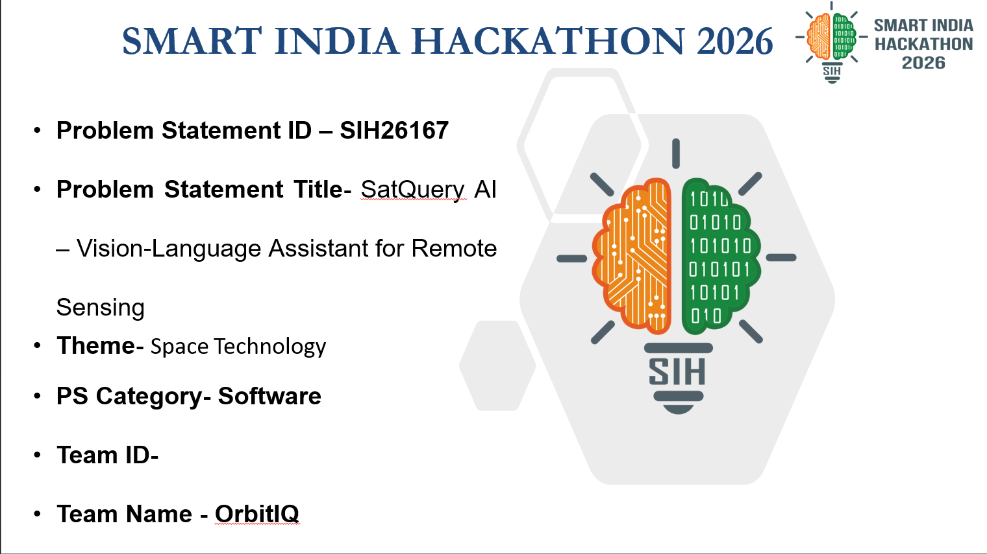

SMART INDIA HACKATHON 2026
Problem Statement ID – SIH26167
Problem Statement Title-
Theme-
PS Category- Software/Hardware
Team ID-
Team Name (Registered on portal)

Slide 2
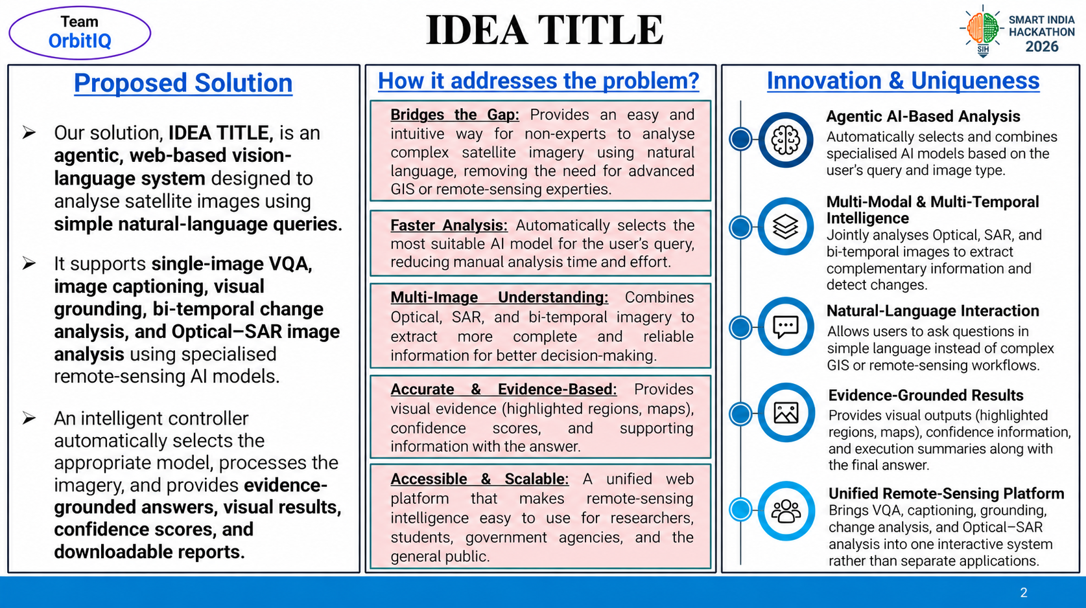

Slide 3
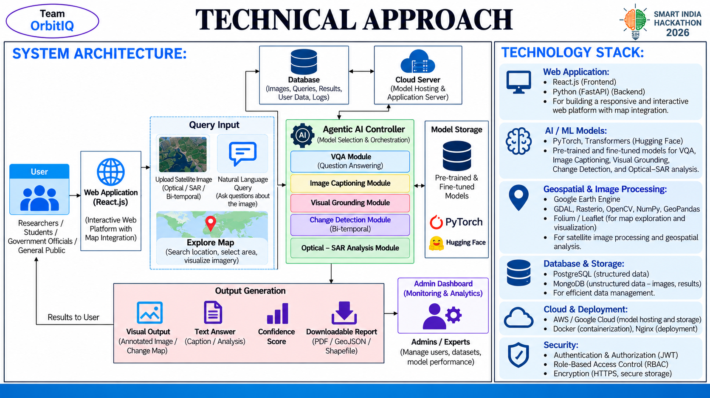

Slide 4
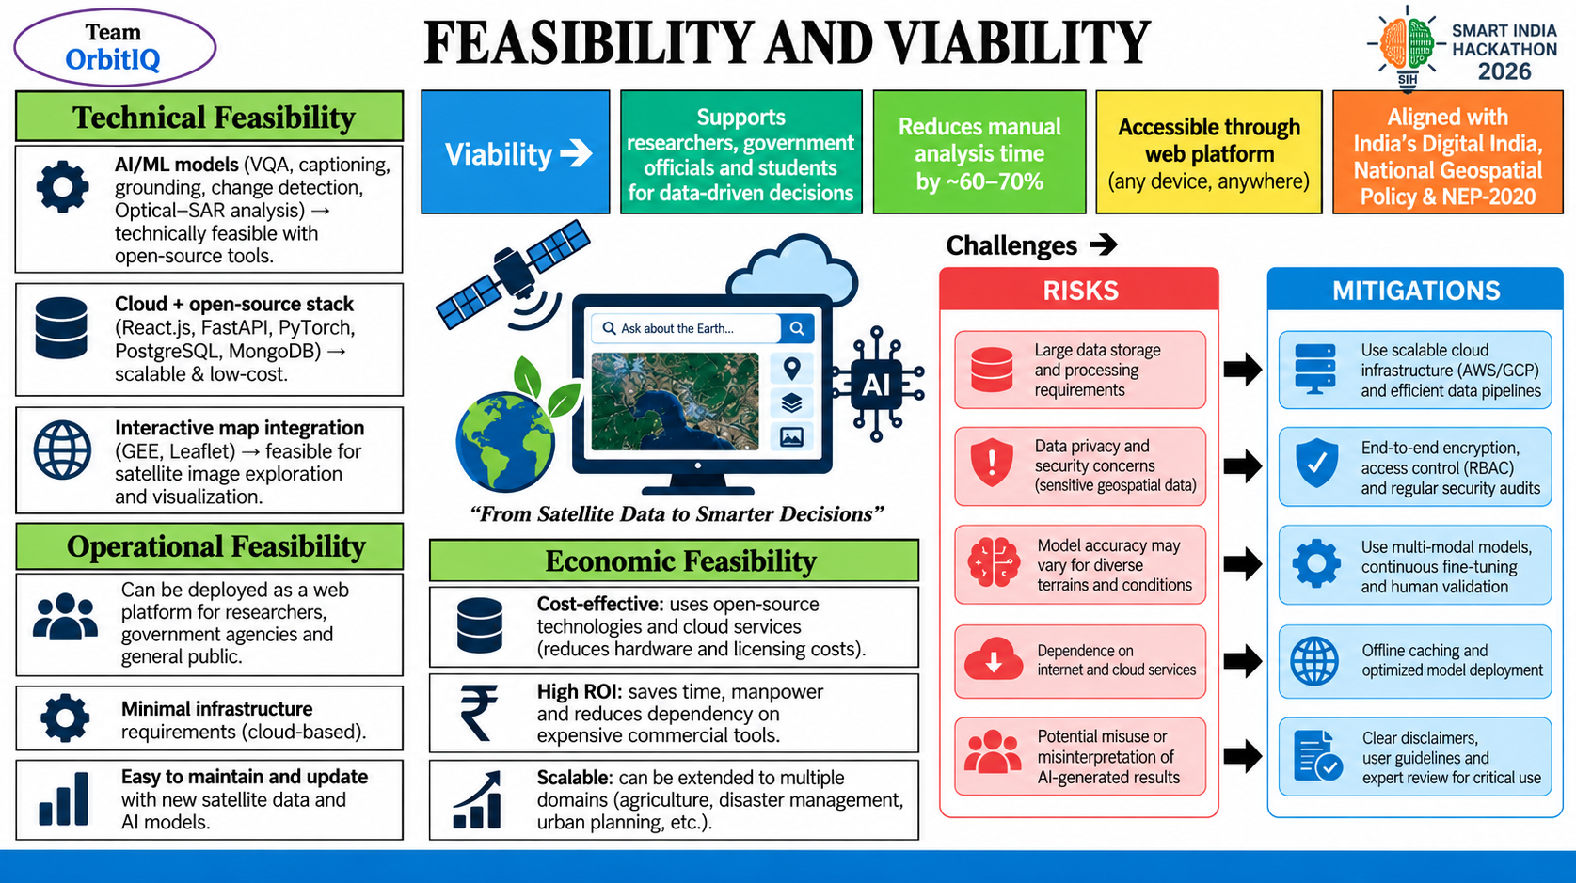

Slide 5

IMPACT AND BENEFITS
Your Team Name

Slide 6
